Slide 1


MUTHYAMMAL COLLEGE OF ENGINEERING,RASIPURAM – 637 408.
DEPARTMENT OF COMPUTERSCIENCEAND ENGINEERING
PROJECT
Guided by :
T.Sindhiya M.E(CSE).,
Presented by :
1.S.ArunKumar 621719104003
2.M.Athavan 3.R.Gokulraj 4.J.Velmani
621719104004
621719104011
621719104052

Slide 2

Project Name
“Trading journal and stocks visualizing with Tradycom”
Domain Name:
Web development

Slide 3
ABSTRACT
Trading journal and stock visualizing are essential tools for traders to improve their trading performance. A trading journal is a record-keeping tool that helps traders track their trades and analyse their performance. By keeping a detailed record of their trades, traders can identify patterns in their behaviour, assess their strengths and weaknesses, and make informed decisions to improve their trading strategies.
On the other hand, stock visualizing tools help traders to analyze and interpret data, trends, and patterns in the stock market. These tools provide traders with a visual representation of the market, which makes it easier for them to identify key indicators and make informed trading decisions.
Together, a trading journal and stock visualizing tools are powerful resources for traders looking to improve their trading performance. By using these tools in conjunction with each other, traders can gain valuable insights into their trading behavior, identify profitable patterns, and make data-driven decisions to increase their profitability in the stock market.

Slide 4
LITERATURE SURVEY
S.No | Title | Author | Approached Used | Description
1. | An Intermarket Approach to BetaRotation:The Strategy Signal and Power of Utilities | Bilello, Charles V., and Michael A Gayed | The Strategy Signal and Power of Utilities | It is often said by proponents of the Efficient Market Hypothesis that no strategy can consistently outperform a simple buy and hold investment in broad stock averages over time.
2. | “Dow’s Theory of Confirmation Modernized.” | Dahlberg.C | TA on any asset class as long as the asset type has historical time series data. | On the other hand, the concept of technical analysis will remain the same irrespective of the asset you are studying.

Slide 5
LITERATURE SURVEY
S.No | Title | Author | Approached Used | Description
3. | Magnifying Returns in Stocks | Michael A., and Charles V. Bilello. | Using leverage to magnify performance is an idea that has enticed investors and traders throughout history. | Using leverage to magnify performance is an idea that has enticed investors and traders throughout history.
4. | Evaluation of Systematic Trading Programs | Munenzon, Mikhail. | key areas of evaluation of systematic trading programs: intellectual framework, signal generation, risk management. | This paper is intended as a non-technical overview of the issues I found valuable in evaluation of systematic trading programs both as a systematic trader.

Slide 6
EXISTING SYSTEM
A trading journal is a log that you can use to record your trades.
Traders use a trading journal to reflect upon previous trades so that they may evaluate themselves, and you should too!
In existing system you can only access the foreign stock exchange market values and
trades and if you want to explore more about the thing it asks for premium subscription.

Slide 7
DISADVANTAGES
In this existing system we cannot access and visualise the Indian Market data.
It doesn't have trading journal which keeps track of records of trades which will be used
to realising their mistakes.
Its not user friendly interface.

Slide 8
PROPOSED SYSTEM
A trading journal is a log that you can use to record your trades.
Traders use a trading journal to reflect upon previous trades so that they may evaluate themselves.
We can track the data of the live data in NSE which will show the top gainers and top losers. For Options traders it will show the PE data & CE data.

Slide 9
ADVANTAGES
A trading journal helps you keep track of your trades and trading progress and helps you
become a more efficient trader by learning where you do well and where you do less well.
This way you can focus on what you're best at and see where you need to grow.
Its more reliable and user friendly interface than existing system.

Slide 10
LIST OF MODULES
Trading journal
Stocks visualizing
Trading charts
Account Management

Slide 11
Trading journal
WHAT IS A TRADING JOURNAL?
A trading journal is a log that you can use to record your trades. Traders use a trading journal to reflect upon previous trades so that they may evaluate themselves, and you should too! You can use journals to evaluate where you can improve your trading. They are a useful form of record keeping.
WHY TRADING JOURNALS ARE USEFUL
Main reasons to keep a trading journal include:
They help you identify weak points and strong points in your style.
Journals could increase trading consistency.
The journal could keep you accountable.
The journal can help you choose your best trading strategy.
Keeping a journal is a simple yet extremely effective way to improve a trading plan. A trading plan is a set of rules and guidelines you will follow that includes strategy, risk management, and trader psychology.

Slide 12
Stocks visualizing
Stock analysis is a method for investors and traders to make buying and selling decisions. By studying and evaluating past and current data, investors and traders attempt to gain an edge in the markets by making informed decisions.
The notion of stock analysis relies on the assumption that available market information can be used to determine the intrinsic value of a stock. In the primary methods discussed below, investors use financial statements, stock price movement, market indicators, or industry trends to make investment decisions.
Fundamental analysis concentrates on data from sources, including financial records, economic reports, company assets, and market share. To conduct fundamental analysis on a public company or sector, investors and analysts typically analyze the metrics on a company’s financial statements – balance sheet, income statement, cash flow statement, and footnotes.

Slide 13
Trading charts
The trading chart displays information that can help you decide when to enter and exit a position. There are many kinds of trading charts: bar charts, line charts, point and figure, market profile and candlesticks. For this example, we’ll focus on candlesticks, one commonly used chart type.
A candlestick chart is a combination of a line chart and a bar graph. You can change chart types depending on your preferred view, but most traders prefer candlesticks because of the depth of information each stick can convey. Each candlestick gives you four key pieces of information within your selected time interval.

Slide 14
Account Management
To check the balance of your trading account, log in to your account using the trading platform or mobile app provided by your broker. Once you're logged in, you should be able to see your account balance displayed prominently on the screen.
To add funds to your trading account, go to the "Deposit" or "Add Funds" section of your trading platform or mobile app. Choose your preferred deposit method, such as bank transfer or credit card, and enter the amount you wish to add. Follow the prompts to complete the transaction.

Slide 15
If you want to withdraw funds from your trading account, go to the "Withdraw" or "Request Withdrawal" section of your trading platform or mobile app. Choose your preferred withdrawal method, such as bank transfer or credit card, and enter the amount you wish to withdraw. Follow the prompts to complete the transaction.
To place trades in your trading account, use the trading platform or mobile app provided by your broker. You will need to select the asset you wish to trade, such as stocks, forex, or commodities, and choose whether to buy or sell. Enter the amount you wish to trade, and follow the prompts to complete the transaction.

Slide 16
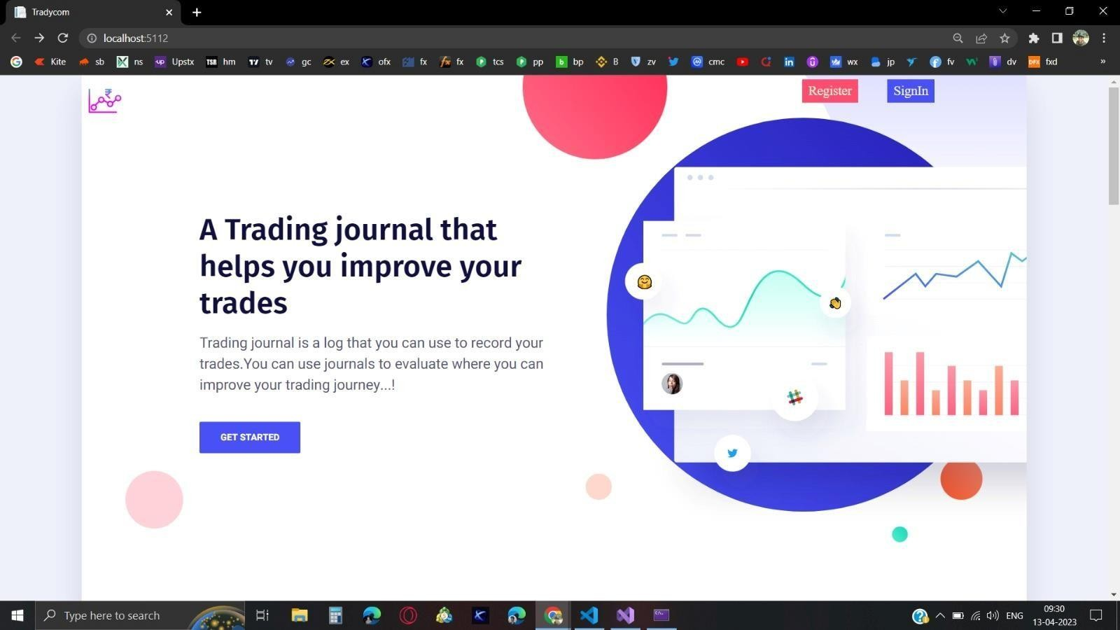
Landing Page

Slide 17
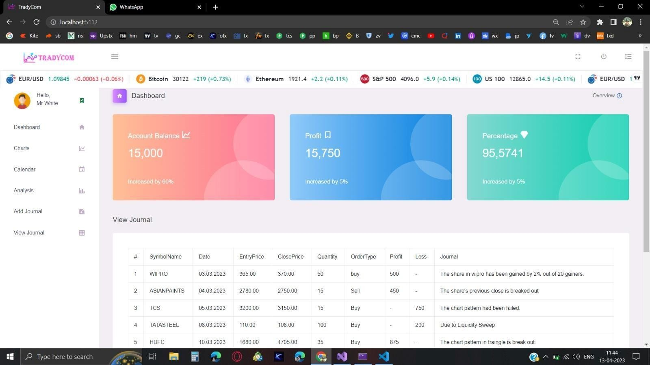
Dashboard

Slide 18
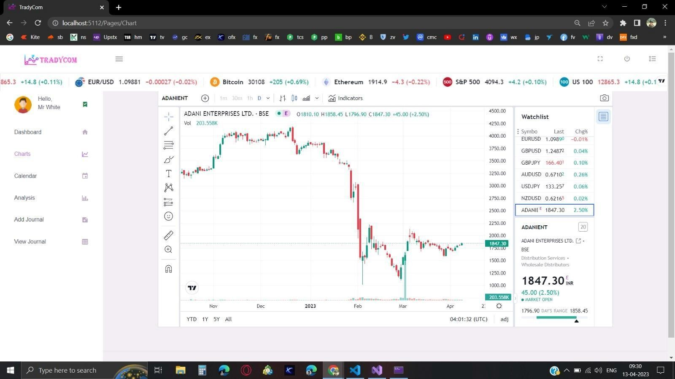
Chart

Slide 19
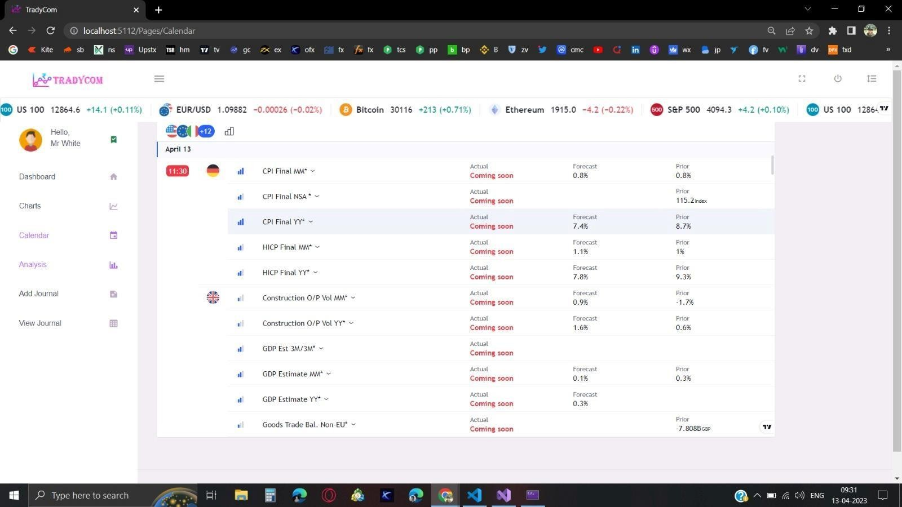
Calendar

Slide 20
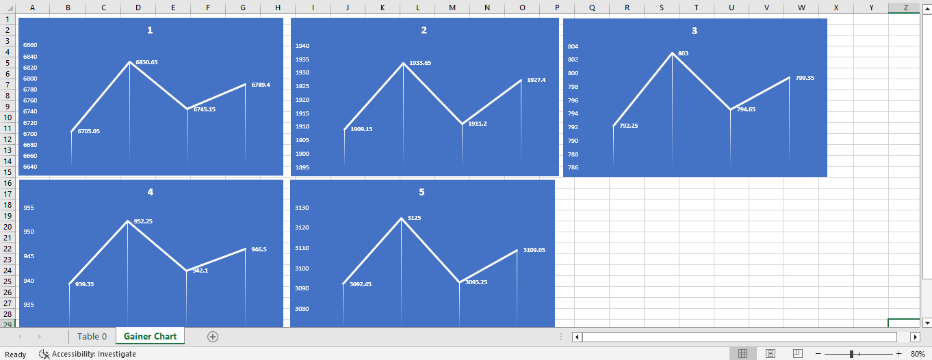
Top Gainers

Slide 21
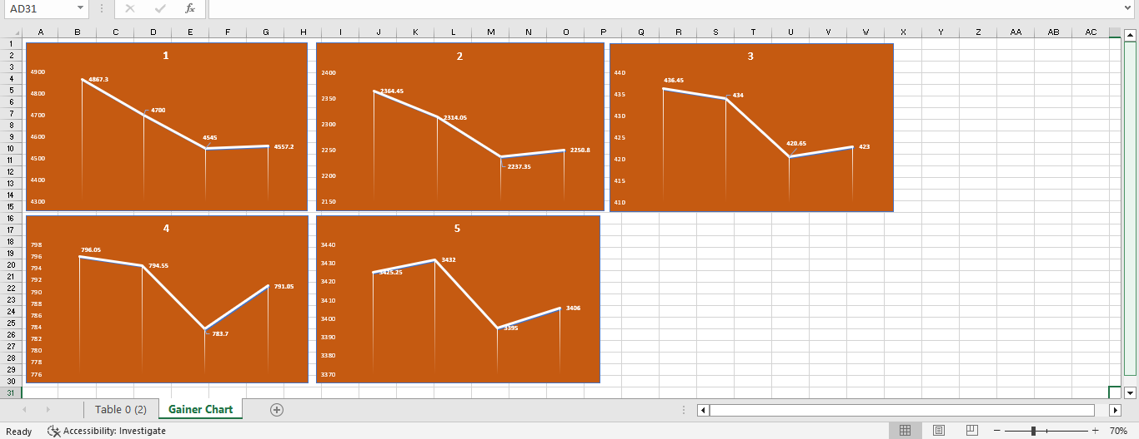
Top Losers

Slide 22
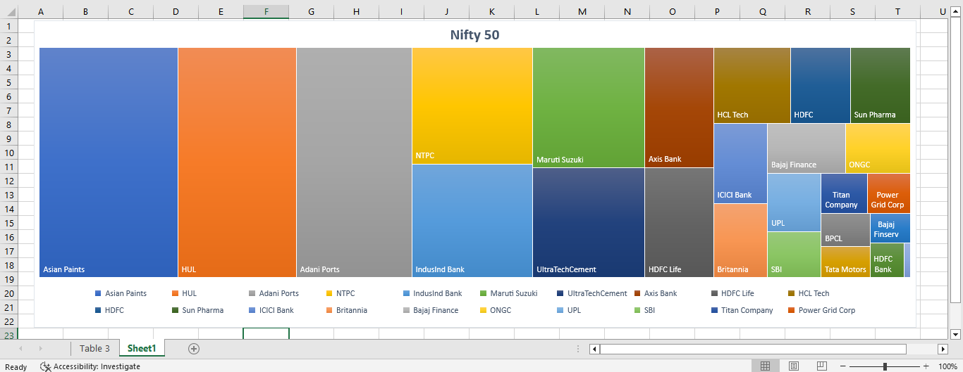
NIFTY 50 Heat Map

Slide 23
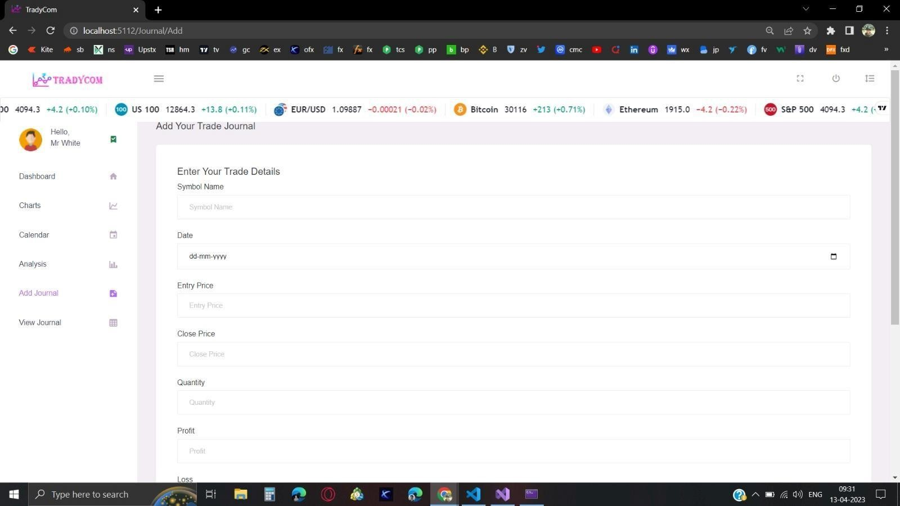
Adding Journal

Slide 24
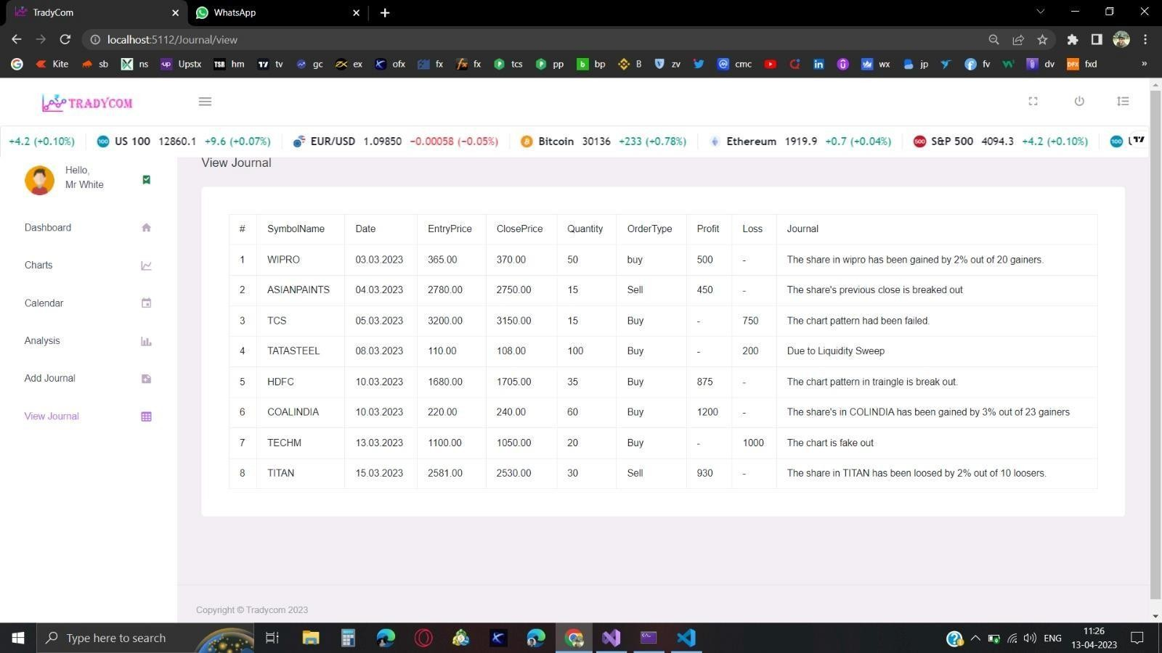
Journal page

Slide 25
REFERENCES
Atip Keeratipish, “Techniques for Finding Good Stocks and Building Stock Portfolio for
Salary Man,” Available from: https://www.youtube.com/watch?v=TNzW_aot1Og.
https://en.wikipedia.org/wiki/Fundamental_analysis.
https://www.sapanalytics.cloud/resources-chart-type-guide/.
"SET," The Stock Exchange of Thailand, Available from: https://www.set.or.th/set/mainpage.do?language=en&country=US.
"Settrade.com," Settrade.com Co., Ltd., Available from: https://www.settrade.com/.

Slide 26
THANKYOU

